Slide 1
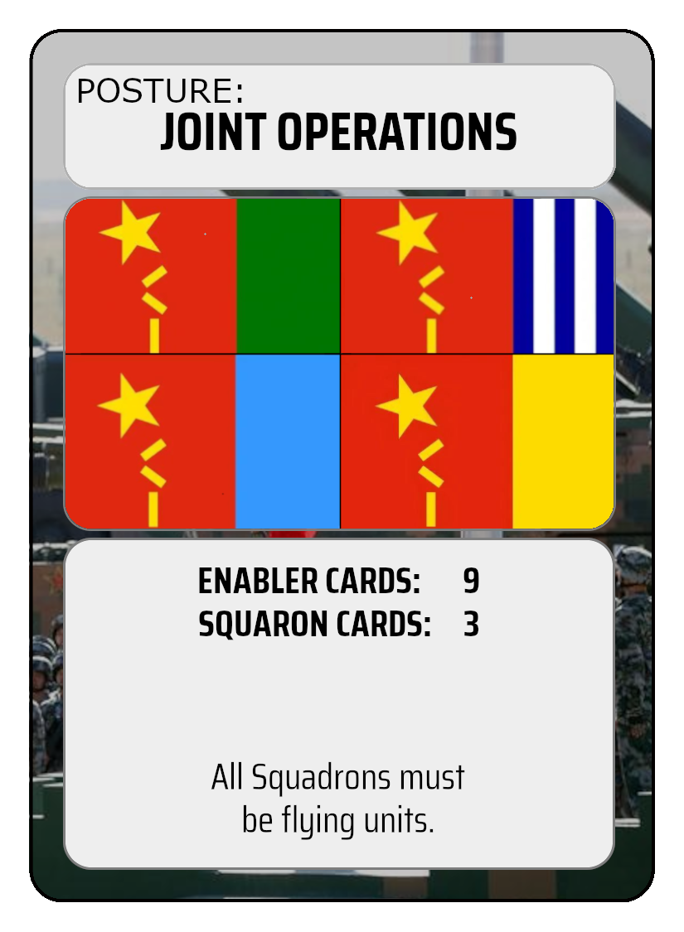
Posture Name
Enabler Limit
Special Conditions
Squadron Limit

Slide 2
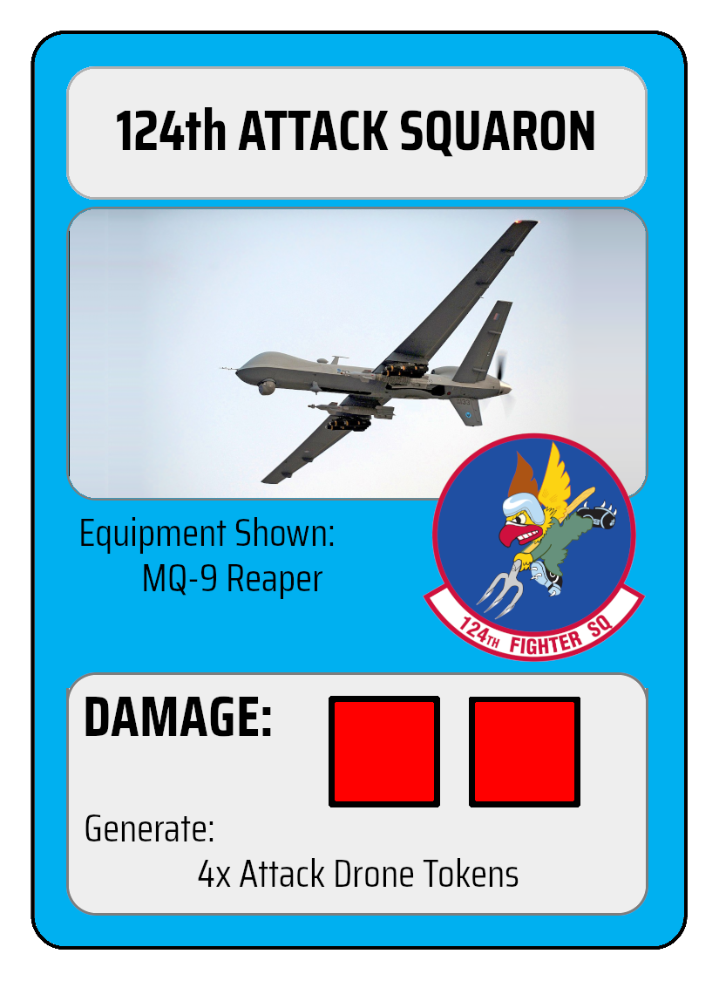
Squadron Name
Squadron Patch (No Gameplay Effect)
Equipment Description (No Gameplay Effect)
Number and Type of Tokens Generated
Squadron Ground Crew Health

Slide 3
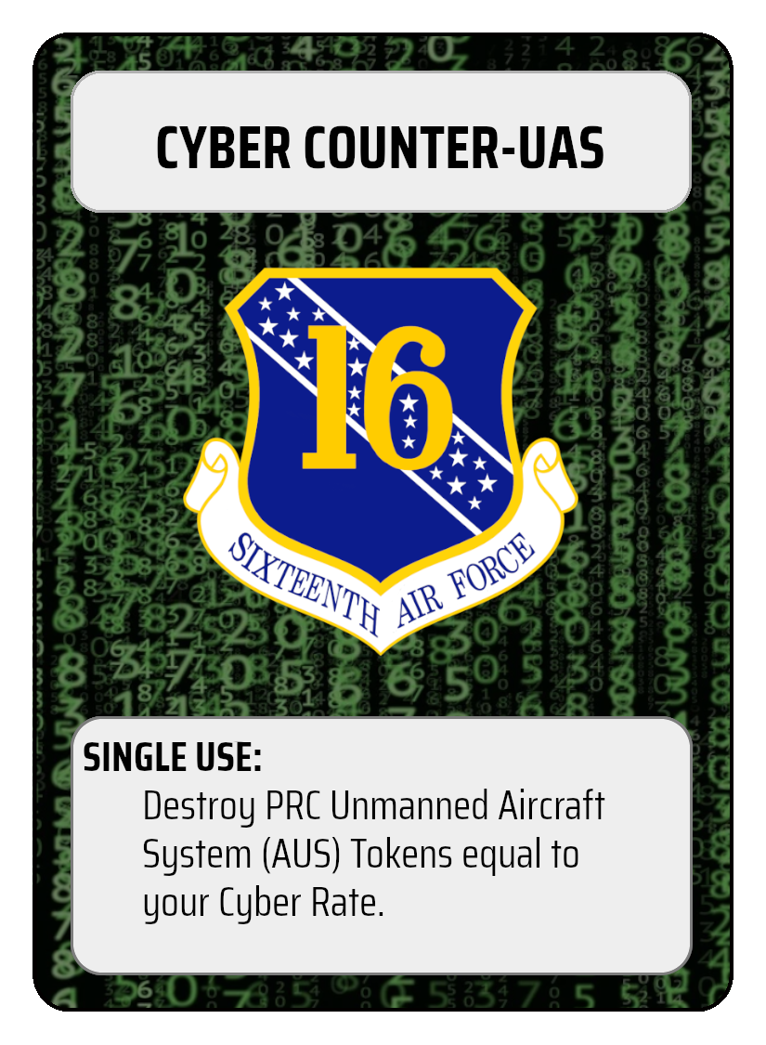
Enabler Name
Single vs. Multi Use Identifier
Enabler Effects
Background Denotes Warfighting Domain

Slide 4
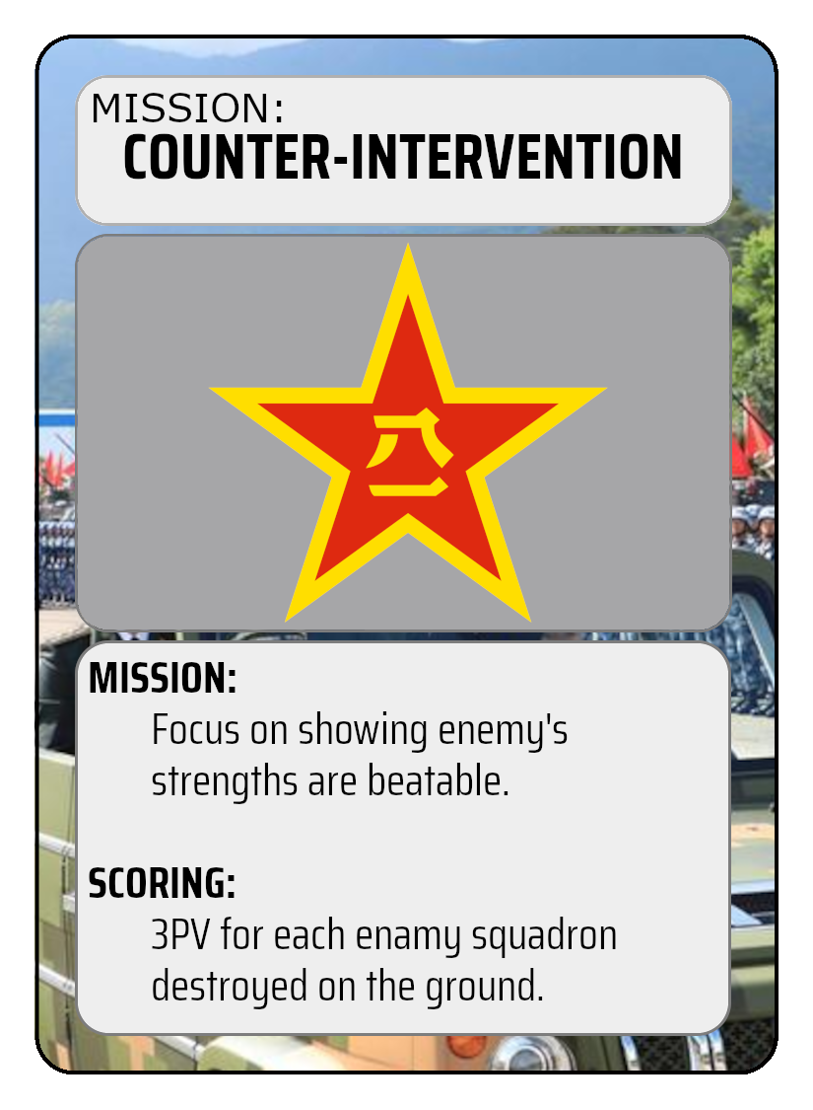
Mission Name
Context (No Gameplay Effect)
Scoring Conditions

Slide 5
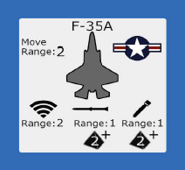
Token Name
Movement Range
Sensor Range
Border and Roundel denote whether the token is a PRC or US Token
Ground Attack Range and Damage Die
Air Attack Range and Damage Die

